Slide 1

Phát Triển Ứng Dụng DHKTPM17A - 420300350104
Nhóm 06​
Phần Mềm Quản Lý Bán Hàng
Tại Cửa Hàng Bán Quần Áo Thời Trang

Slide 2



Thành Viên Nhóm 06
Lê Minh Bảo
Trương Quốc Bảo
Lê Hoàng Nam
21007881
Nhóm Trưởng
21017351
Thành Viên Nhóm
21002211
Thành Viên Nhóm

Slide 3

Nội Dung
Giới Thiệu
Yêu Cầu Ứng Dụng
Giới thiệu sơ lược về phần mềm.
Các yêu về cầu nghiệp vụ và hệ thống của ứng dụng.
Phân Tích – Thiết Kế
Demo Ứng Dụng và Hạn Chế Còn Tồn Đọng
Phân tích Usecase tổng quát và đặc tả các Usecase quan trọng của phần mềm.
Thiết kế mô hình lớp, cơ sở dữ liệu và phân luồng màn hình của phần mềm.
Hiện thực các chức năng quan trọng của ứng dụng.
Các hạn chế còn tồn đọng cần khắc phục.

Slide 4
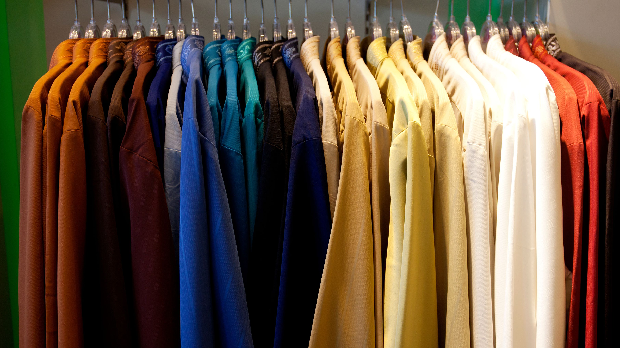
Giới Thiệu
At Contoso, we empower organizations to foster collaborative thinking to further drive workplace innovation. By closing the loop and leveraging agile frameworks, we help business grow organically and foster a consumer-first mindset.

Slide 5

Yêu Cầu Ứng Dụng
Close the gap
Our product makes consumer lives easier, and no other product on the market offers the same features
Target audience
Gen Z (18-25 years old)
Cost savings
Reduce expenses for replacement products
Easy to use
Simple design that gives customers the targeted information they need

Slide 6
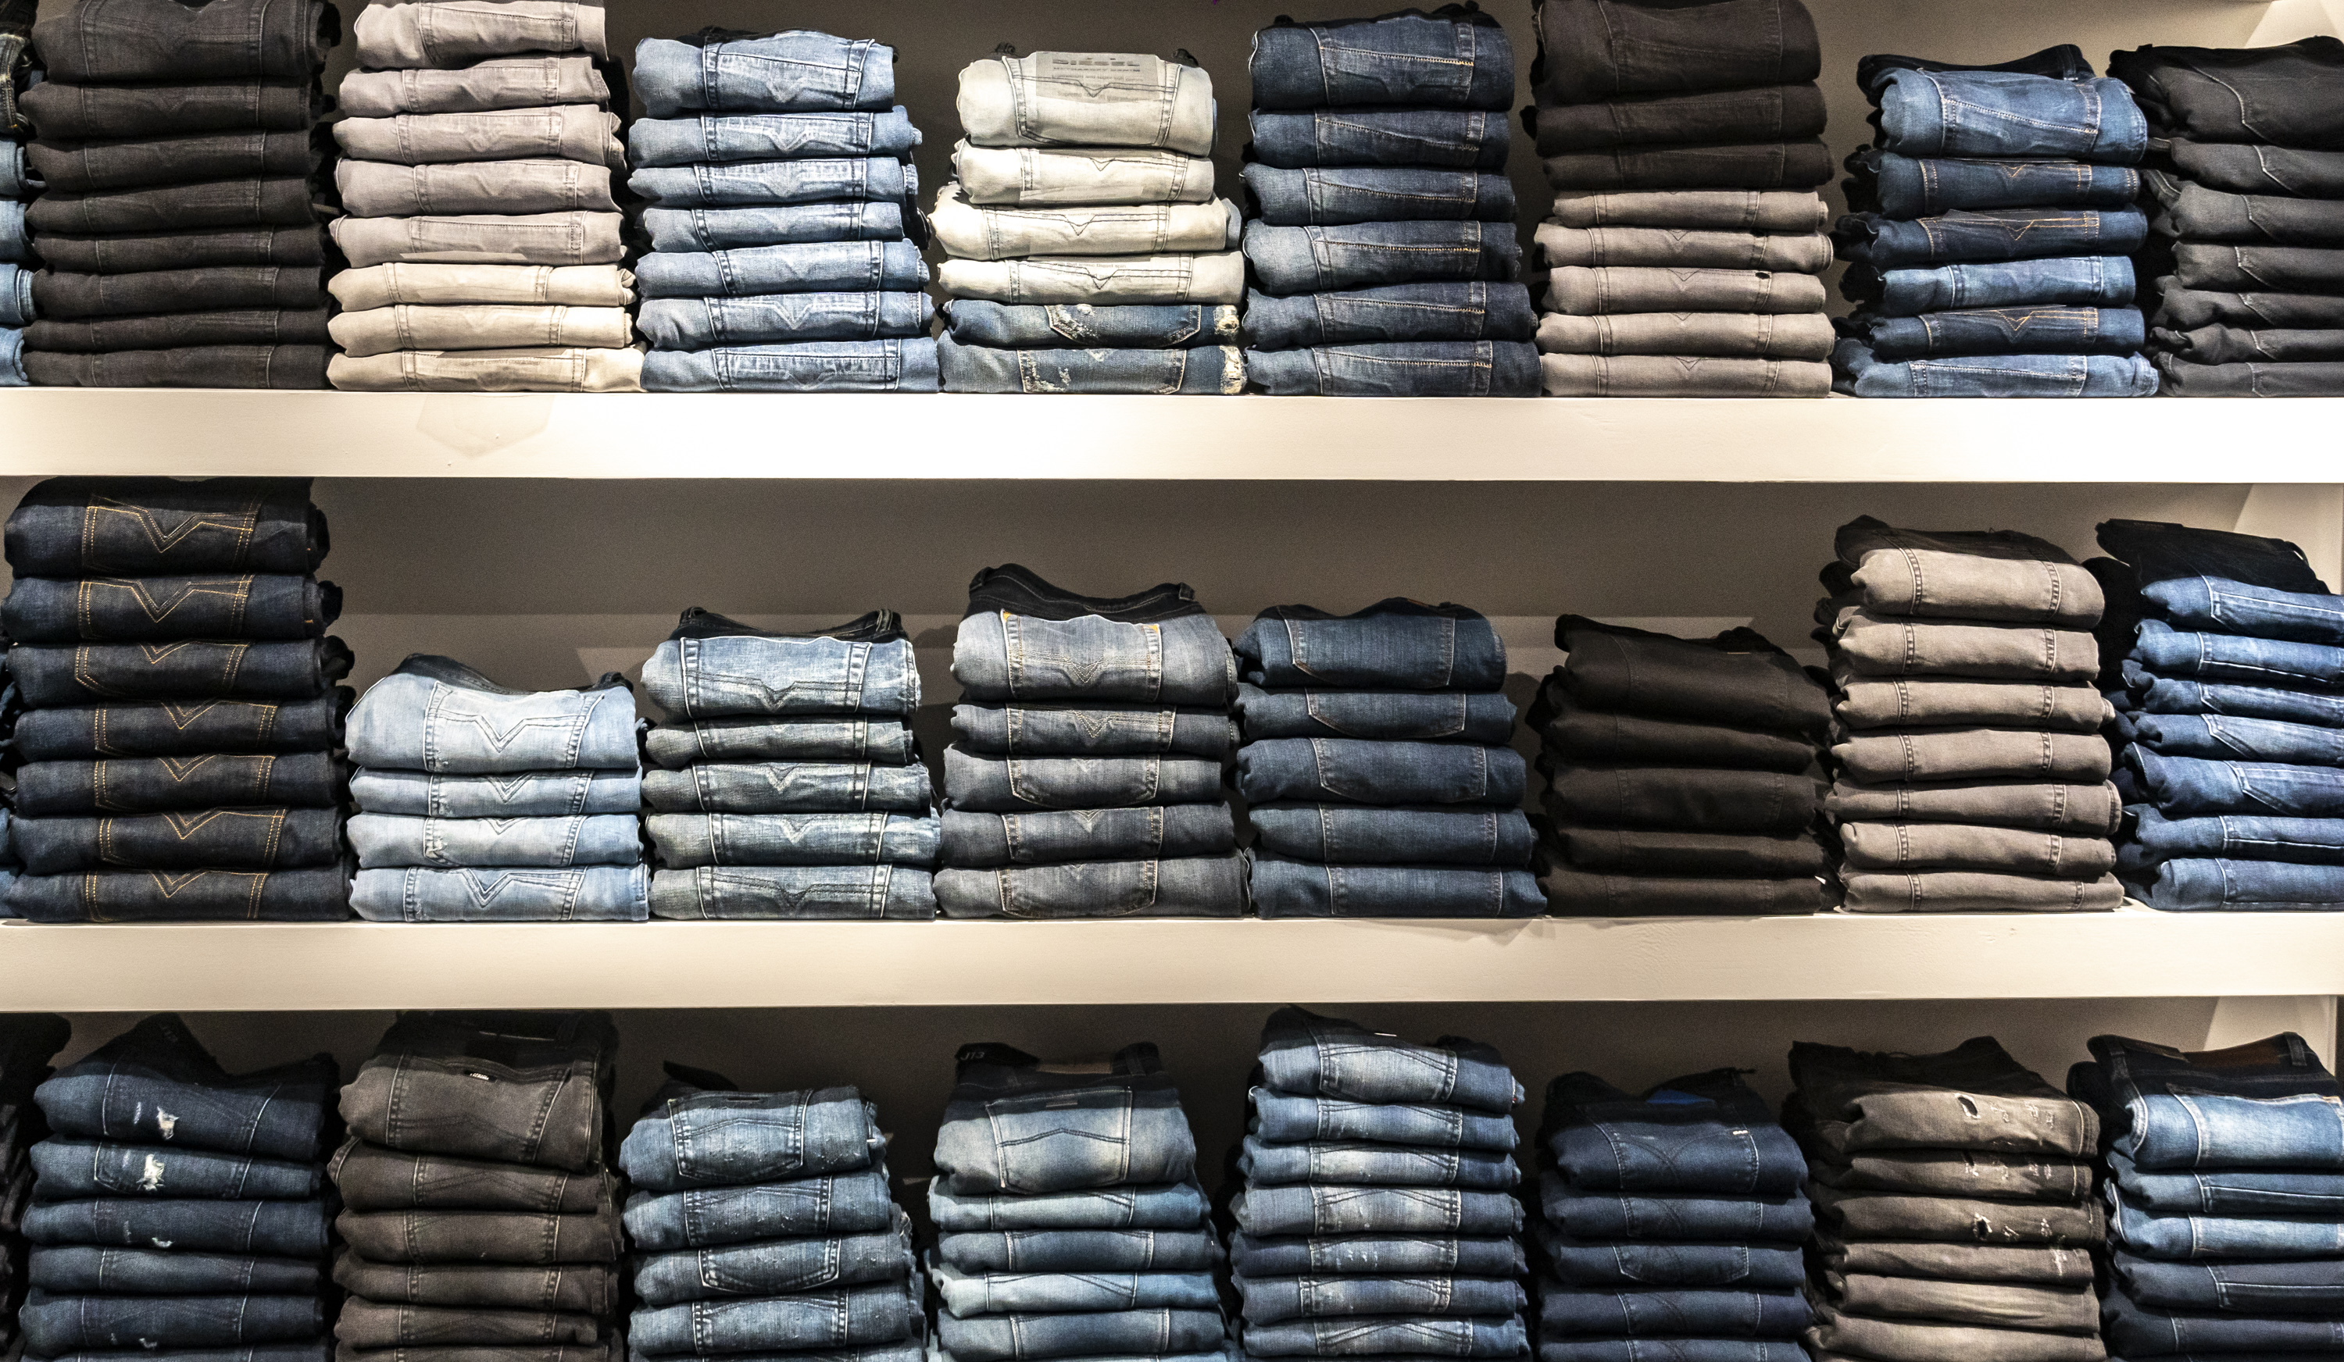
Phân Tích – Thiết Kế

Slide 7

Product overview
Unique
Tested
Only product specifically dedicated to this niche market
Conducted testing with college students in the area
First to market
Authentic
First beautifully designed product that's both stylish and functional
Designed with the help and input of experts in the field

Slide 8

Product benefits
Cool and stylish product
Areas for community connections
Online store and market swap

Slide 9



Business model
Research
Abstract
Design
We based our research on market trends and social media
We believe people need more products specifically dedicated to this niche market
Minimalist and easy to use

Slide 10

Market overview
$3B
$2B
$ 1B
Opportunity to build
Fully inclusive market
Total addressable market
Freedom to invent
Selectively inclusive market
Serviceable available market
Few competitors
Specifically targeted market
Serviceable obtainable market

Slide 11



Market comparison
$3B
Opportunity to build
Addressable market
$2B
Freedom to invent
Serviceable market
$1B
Few competitors
Obtainable market

Slide 12

Our competition
Contoso
Competitors
Our product is priced below that of other companies on the market
Design is simple and easy to use, compared to the complex designs of the competitors
Affordability is the main draw for our consumers to our product
Company A Product is more expensive
Companies B & C Product is expensive and inconvenient to use
Companies D & E Product is affordable but inconvenient to use

Slide 13
Competitive layout
CONVENIENT
A
Contoso
EXPENSIVE
AFFORDABLE
D
C
E
B
INCONVENIENT

Slide 14
Growth strategy
How we’ll scale in the future
Feb 14/12/2023
May 14/12/2023
Oct 14/12/2023
Roll out product to high profile or top-level participants to help establish the product
Release the product to the general public and monitor press release and social media accounts
Gather feedback and adjust product design as necessary

Slide 15
Traction
Forecasting for success
Key metrics
Revenue by year
 | Clients | Orders | Gross revenue | Net revenue
14/12/2023 | 10 | 1100 | $10,000 | $7,000
14/12/2023 | 20 | 200 | $20,000 | $16,000
14/12/2023 | 30 | 300 | $30,000 | $25,000
14/12/2023 | 40 | 400 | $40,000 | $30,000

Slide 16
Two-year action plan
Draft blueprints
Run focus groups
Gather feedback
14/12/2023
JAN
FEB
MAR
APR
MAY
JUN
JUL
AUG
SEP
OCT
NOV
DEC
14/12/2023
JAN
FEB
MAR
APR
MAY
JUN
JUL
AUG
SEP
OCT
NOV
DEC
Test design
Launch design
Deliver to client

Slide 17
Financials
 | Year 1 | Year 2 | Year 3
Income
Users | 50,000 | 400,000 | 1,600,000
Sales | 500,000 | 4,000,000 | 16,000,000
Average price per sale | 75 | 80 | 90
Revenue @ 15% | 5,625,000 | 48,000,000 | 216,000,000
Gross profit | 5,625,000 | 48,000,000 | 216,000,000
Expenses
Sales & marketing | 5,062,500 | 38,400,000 | 151,200,000 | 70%
Customer service | 1,687,500 | 9,600,000 | 21,600,000 | 10%
Product development | 562,500 | 2,400,000 | 10,800,000 | 5%
Research | 281,250 | 2,400,000 | 4,320,000 | 2%
Total expenses | 7,593,750 | 52,800,000 | 187,920,000

Slide 18








Meet the team
Takuma Hayashi
Mirjam Nilsson
Flora Berggren
Rajesh Santoshi
President
Chief Executive Officer
Chief Operations Officer
VP Marketing
Graham Barnes
Rowan Murphy
Elizabeth Moore
Robin Kline
VP Product
SEO Strategist
Product Designer
Content Developer

Slide 19
Funding
Properties
Angel investments
Cash
Shares
$12,000
$14,000
$32,000
$82,000
Revenue obtained from property rentals
Amount obtained through other investors
Liquid cash we have on hand
Number of shares converted into USD

Slide 20

Summary
At Contoso, we believe in giving 110%. By using our next-generation data architecture, we help organizations virtually manage agile workflows. We thrive because of our market knowledge and great team behind our product. As our CEO says, "Efficiencies will come from proactively transforming how we do business."

Slide 21


Thank you
Mirjam Nilsson​
206-555-0146
mirjam@contoso.com
www.contoso.com

